Slide 1
From idea to impact: How we can help you mobilize research knowledge
Dr. Bronwynne Wilton and Dr. Owen Roberts
University of Guelph
April 11th , 2013

Slide 2
Outline
Why Knowledge Mobilization
KMb Barriers and Best Practices
KMb in the Research Grant (OMAF & MRA – U of G Example)
Telling your story: Research Communications

Slide 3
Why ‘Knowledge Mobilization’?
Increasing emphasis for publicly funded research to be relevant to society
Increasing need to solve complex societal issues
“The answer, I am convinced, lies in what I call the diplomacy of knowledge, defined as our ability and willingness to work together and share our learning across discipline and borders.” (David Johnston, G&M 2012)

Slide 4
Addressing the Know-Do Gap: Asking and Answering 3 Questions:
Are we doing the research that is needed? Specifically research that research users need?
Are we applying the research that has been done? Are we doing that effectively?
How can we accelerate the transformation of knowledge into action? Are behaviours changing?
Notes:
4

Slide 5
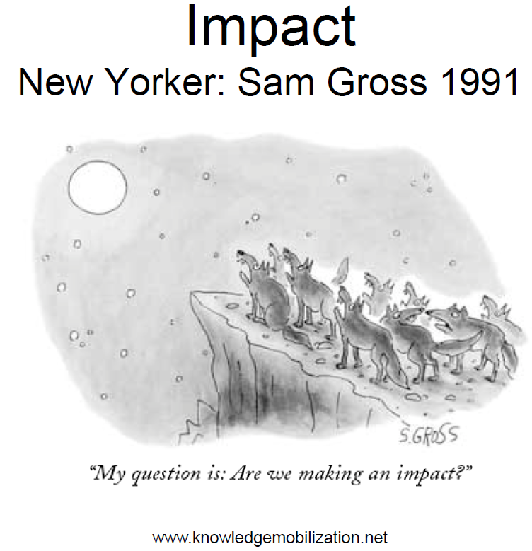

Slide 6
Definitions of Knowledge Mobilization
Knowledge mobilization involves making knowledge readily accessible – and thereby useful to any number of individuals and groups in society – by developing ways in which groups can work together collaboratively to produce and share knowledge.
http://whatiskt.wikispaces.com/Knowledge+mobilization

Slide 7
Definitions of Knowledge Mobilization
Knowledge mobilization connects research and researchers with people and organizations seeking to develop sustainable solutions to social, environmental, economic and cultural challenges.

Slide 8
Definitions of Knowledge Mobilization
Knowledge mobilization relates to the flow of knowledge and information among multiple individuals and groups, leading to intellectual, social, and economic benefits. Knowledge mobilization aims to allow the exchange of research knowledge both between university researchers and the wider community, and across different academic disciplines.

Slide 9
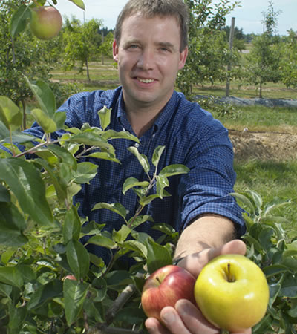
Definition in the OMAF and MRA-U of G Partnership
… the synthesis, exchange and application of knowledge (resulting from interactions among one or more of the University, University researchers, OMAFRA, various internal and external stakeholders of the University and OMAFRA, and various members of the public) involving dissemination of the results of research and other activities occurring pursuant to the agreement.
Notes:
-demand driven research –priority setting is key
-Pull, push, knowledge exchange

Slide 10
More simply…
“KMb/KTT” accelerates the transformation
of research knowledge into use.

Slide 11
KTT Push –Pull
Knowledge Exchange
Research Producers Push
Research
Users Pull
Understand your different users.
11
Notes:
This diagram shows the movement of information between the researcher and the research user. Research users pulls information they demand for their needs (demand driven research), while researchers push their research towards them.
Research push is fairly straightforward- an example is creating a research project based on a gap identified in a prior project.
In research pull, the user requests information and pulls it through the delivery channel. An example of pull is an industry request for consultation, based on your research.
The interface between them creates an opportunity for knowledge exchange, or co-creation of research.
11

Slide 12
The OMAF and MRA – U of G Knowledge Translation and Transfer (KTT) Program
$5 million one-time funding 2008-2013
“Knowledge Into Use”
Funding Program
Staffing
Networks

Slide 13
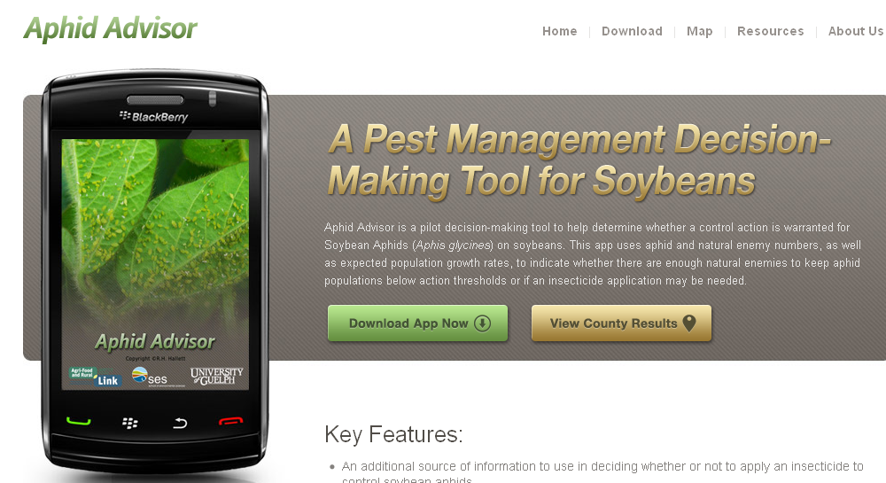
Rebecca Hallett, School of Environmental Sciences

Slide 14
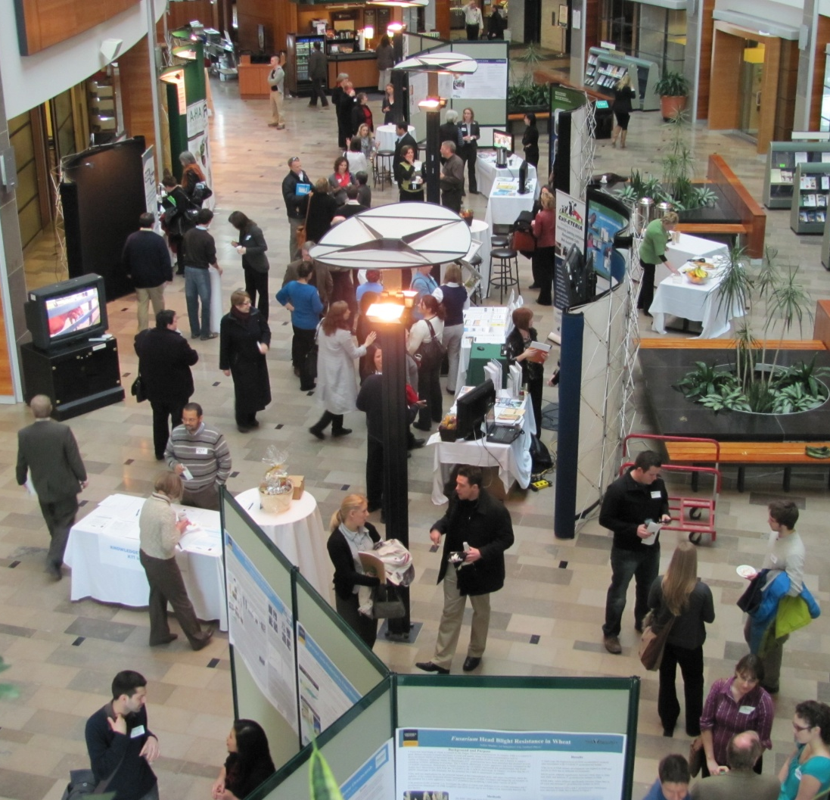
KTT Networking, Events, and Tools
Research Forums and Expos
KTT Community of Practice
Annual Knowledge Exchange Day
KTT Tools
Enhanced Communications
@AgFoodRuralLink

Slide 15
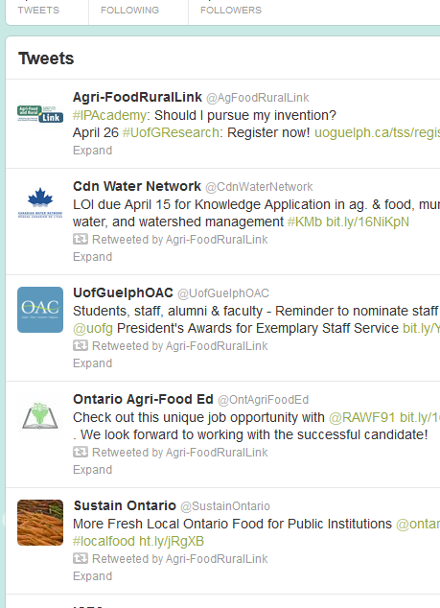
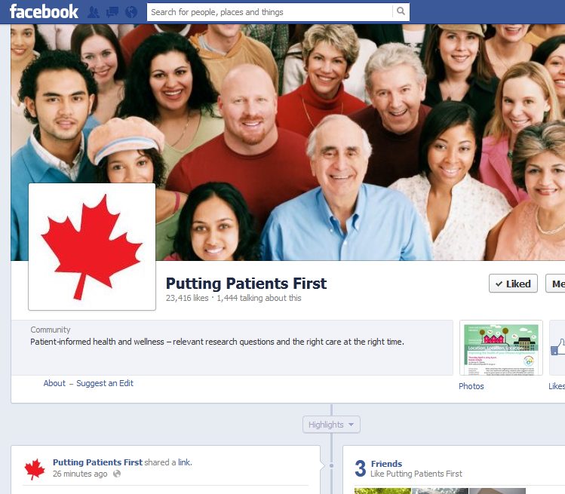
Sharing Knowledge through Social Media

Slide 16
KMb in the research grant*:
Research User Groups | Involvement of Research Users in Project | KTT Methods and Timelines | Explain how users will benefit from the research
This research is important to:_______ | The users of this research are involved in the implementation of the project: _____ | The research users will be communicated via the following ways: _________ | The users benefit from the research in this way:_____
1. | 1. | 1. | 1.
2. | 2. | 2. | 2.
* Component of research proposals for the OMAFRA-U of G Partnership research program.

Slide 17
Successful Kmb
A KMb Plan is essential to enable a clear KMb intention , in other words, to make KMb happen versus let KMb happen
KMb Plan based on 5 key questions
What messages need to be transferred to users/decision-makers?
To whom should research knowledge be transferred? (Who?)
Who should transfer the research knowledge? (By whom?)
By what processes (how) should research knowledge be transferred?
With what effect should it be transferred (evaluation)?
Key points
• Strong Narrative - What are you doing?
• Strong Explanation - Why is it important?
• Link to Future Action - decision, directions, answering a users issue
• Clear statement of potential value to be produced and for whom?
Notes:
A KTT Plan is essential to enable a clear KTT intention , in other words, to make KTT happen versus let KTT happen
KTT Plan based on 5 key questions
What messages need to be transferred to users/decision-makers?
To whom should research knowledge be transferred? (Who?)
Who should transfer the research knowledge? (By whom?)
By what processes (how) should research knowledge be transferred?
With what effect should it be transferred (evaluation)?
Key points
• Strong Narrative - What are you doing?
• Strong Explanation - Why is it important?
• Link to Future Action - decision, directions, answering a users issue
• Clear statement of potential value to be produced and for whom?

Slide 18
Tri-Council Funding and KMb
Social Sciences and Humanities Research Council: Connections grants
http://www.sshrc-crsh.gc.ca/funding-financement/umbrella_programs-programme_cadre/connection-connexion-eng.aspx
Natural Sciences and Engineering Research Council: National Centres of Excellence in KMb
http://www.nce-rce.gc.ca/NetworksCentres-CentresReseaux/NCEKM-RCEMC_eng.asp
Canadian Institutes of Health Research: Knowledge Translation
http://www.cihr-irsc.gc.ca/e/29418.html

Slide 19
Successful Institutional KMb Practices
Research user groups are identified, defined and involved in the research process
Linkages, associations, partnerships and networks defined and active to allow access to knowledge and knowledge flow.
Researchers and research users work in close proximity and/or together on collaborative teams.
Research institutions, knowledge broker agencies, knowledge translations and transfer institutions have the internal capacity and infrastructure to support and engage KMb.
KMb isn’t just “let to happen” it is “made to happen” through planning (KMb Plan)
The plan is implemented through timely transfer efforts.
There are incentives, recognition and rewards for KMb
19
Notes:
19
KTT is involved in priority setting, during the research project and with the research outcomes.
Research user groups are identified, defined and involved in the research process
Linkages, associations, partnerships and networks defined and active to allow access to knowledge and knowledge flow.
Researchers and research users work in close proximity and/or together on collaborative teams.
Research institutions, knowledge broker agencies, knowledge translations and transfer institutions have the internal capacity and infrastructure to support and engage KTT.
KTT isn’t just “let to happen” it is “made to happen” through planning (KTT Plan)
The plan is implemented through timely transfer efforts.
There are incentives, recognition and rewards for KTT

Slide 20
Effective KMb – the take-away message
Develop your KMb plan during the planning stage of your research project.
Understand your audience
Who they are and what are their interests and needs
What terms/concepts/language do they understand
If you could only make 3 points what would you say (key messages)
What communication form is best for your audience.
Don’t wait until you have finished your research- communicate your research throughout your project.
Relationships with users is key.
Notes:
Develop your KTT plan during the planning stage of your research project.
Understand your audience
Who they are and what are their interests and needs
What terms/concepts/language do they understand
If you could only make 3 points what would you say (key messages)
What communication form is best for your audience.
Don’t wait until you have finished your research- communicate your research throughout your project.
Relationships with users is key.

Slide 21
SPARK/Research Communications: Building relationships for a unique approach to knowledge mobilization, translation and transfer

Slide 22
Who we are
A strategic unit supporting University of Guelph research through print, video and audio content

Slide 23
How we can help you
We help mobilize knowledge by helping you translate, transfer and tell your story

Slide 24
SPARK at a glance…
Over the past 24 years, SPARK has become one of the main sources for research communications at Guelph
SPARK is an educational program, giving students opportunities to gain practical, professional journalistic writing and multimedia skills
SPARK students become immersed in the University’s research community, interacting with researchers from all colleges
SPARK produces accurate, engaging material for an array of internal and external stakeholders

Slide 25
SPARK

Slide 26
Research administration
SPARK

Slide 27
Research administration
SPARK
Knowledge translation
External relations department
Research community

Slide 28
Research administration
SPARK
Knowledge translation
Knowledge translation
External relations department
Research community
Knowledge transfer

Slide 29
Research administration
SPARK
Knowledge translation
Knowledge translation
External relations department
Research community
Knowledge transfer
Society/Community/Stakeholders

Slide 30
Research administration
SPARK
Knowledge translation
Knowledge translation
External relations department
Research community
Knowledge transfer
Society/Community/Stakeholders
Industry
Media
Government
Public
Academia

Slide 31
Research administration
SPARK
Knowledge translation
Knowledge translation
External relations department
Research community
Knowledge transfer
Support
Society/Community/Stakeholders
Industry
Media
Government
Public
Academia

Slide 32
Research administration
SPARK
Knowledge translation
Knowledge translation
External relations department
Research community
Knowledge transfer
Support
Feedback
Society/Community/Stakeholders
Industry
Media
Government
Public
Academia

Slide 33
Internal and external emphasis
Internal:
The Insider monthly e-newsletter distributed to faculty
Contribute articles and videos to on-campus departments
SPARK articles and videos are featured on the U of G homepage through our relationship with C&PA
Website, twitter and Facebook for funding opportunities and news
External:
Monthly and bi-monthly article contributions to numerous commodity publications
Ongoing partnership with OMAF -MRA and KTT program, creating articles, publications and videos that highlight partnership-funded research
Research news articles for local media
Create broadcast-news style videos about Guelph research

Slide 34
Some SPARK metrics
SPARK produces 125-150 full length articles (500 words) and 35-40 broadcast videos per year
Output is expected to increase to approx. 200 print articles and more than 50 videos in 2012-13

Slide 35
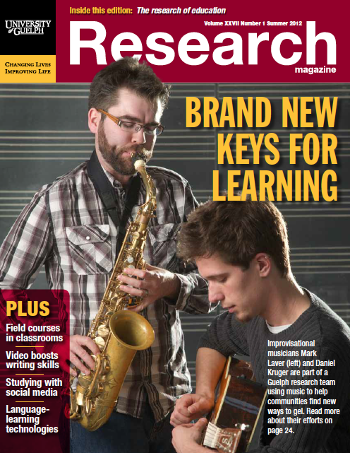
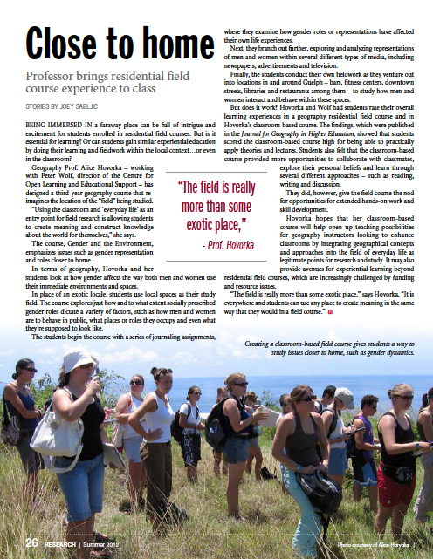
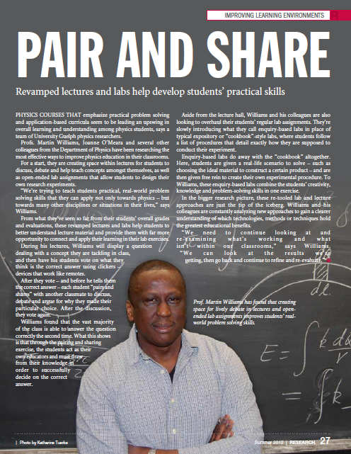
Research magazine

Slide 36
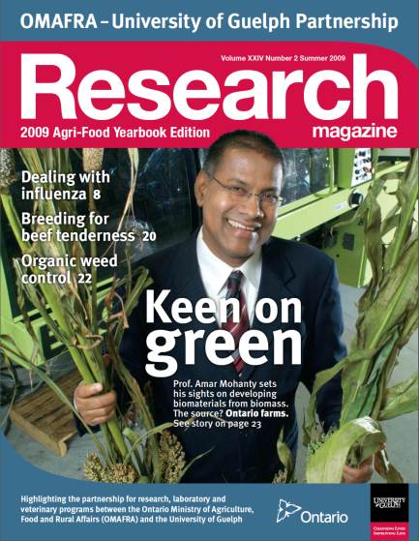
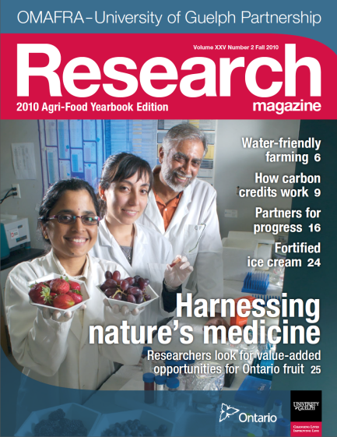
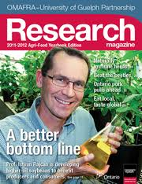
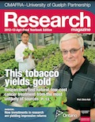
OMAF MRA -U of G Yearbook

Slide 37
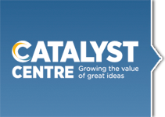
Strategic partnerships
We work with a diverse array of stakeholders, such as:
SHARCNET
The Catalyst Centre
Guelph Mercury
Knowledge Translation and Transfer program

Slide 38
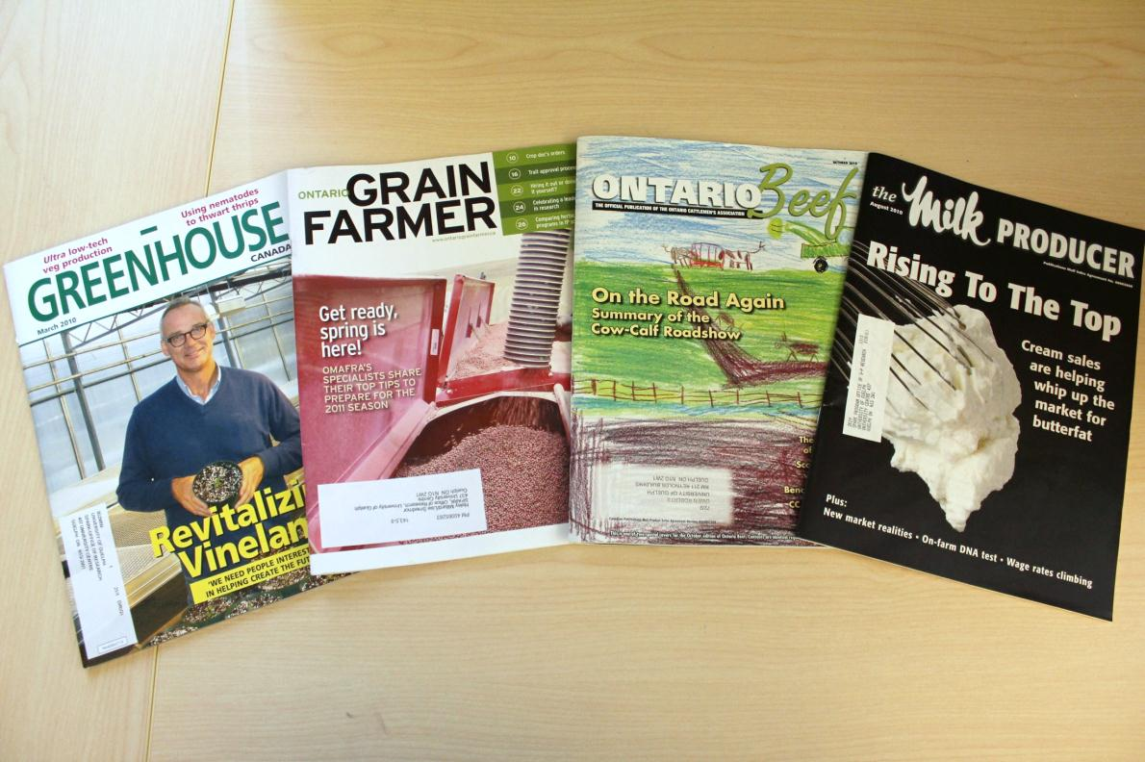

Slide 39
“Four pagers”
Have encompassed the pillars of the Better Planet project, highlighting health, environment, communities and food
New topics: water, animal health, URCs and CRCs

Slide 40
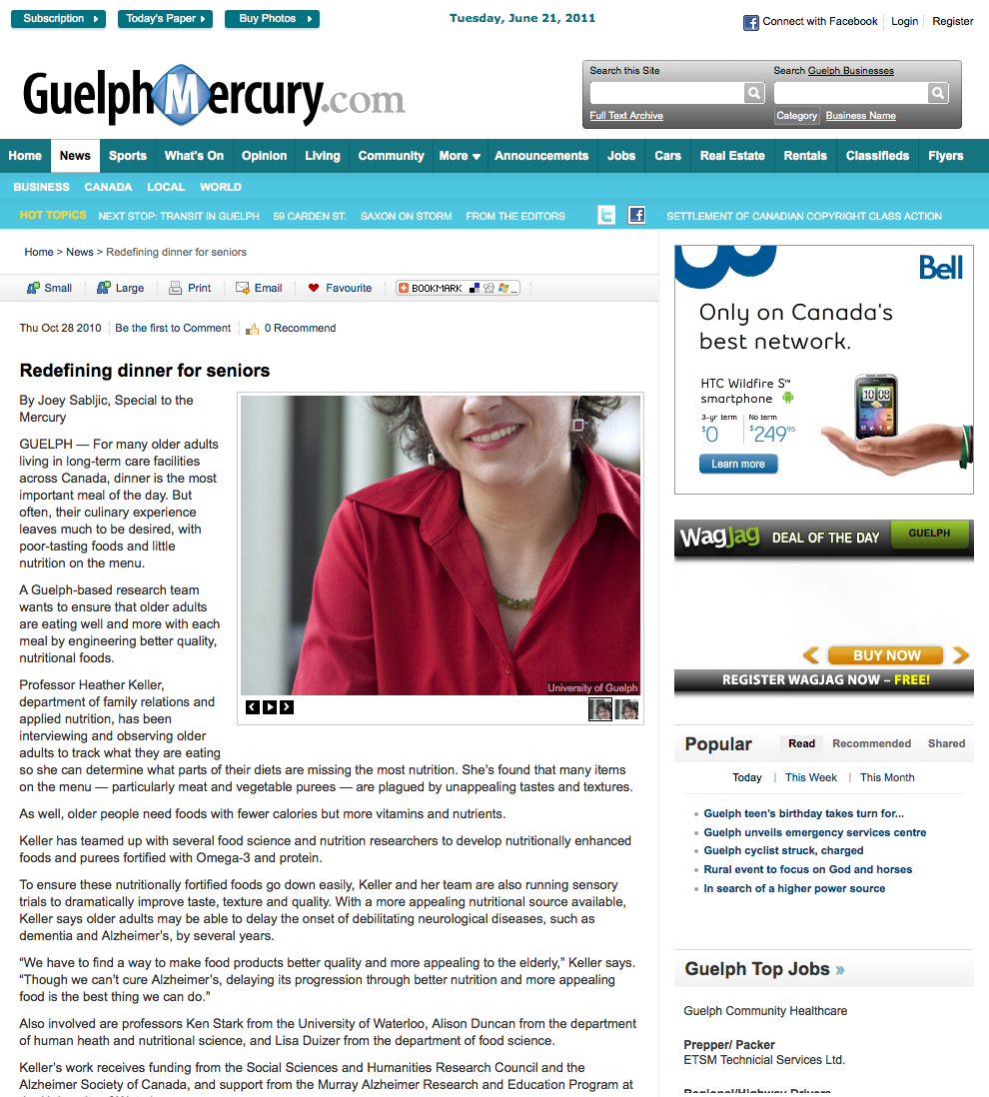
Guelph Mercury media presence
Engaged with the editorial staff at the Guelph Mercury to contribute research articles

Slide 41
SPARK*air
SPARK’s in-house video-production initiative
Producing engaging, informative and colourful research news-based segments
Filming and post-production

Slide 42
KMb and Communications
Working together to mobilize research knowledge at the University of Guelph
Questions?

Slide 43
KMb resources
http://www.uoguelph.ca/omafra_partnership/ktt/en/index.asp
http://www.omafra.gov.on.ca/english/research/kttiindex.htm
http://researchimpact.wordpress.com/about/
http://www.sickkids.ca/Learning/AbouttheInstitute/Programs/Knowledge-Translation/Knowledge-Translation.html
http://ktclearinghouse.ca/
http://www.ktecop.ca/
http://www.inweh.unu.edu/River/KnowledgeManagement/documents/KStar_ConceptPaper_FINAL_Oct29_WEB.pdf

Slide 44
Communications resources
Websites: http://www.uoguelph.ca/research/
http://www.uoguelph.ca/research/spark
Blog: http://sparkuoguelph.wordpress.com/
YouTube channel:http://www.youtube.com/user/sPARKatUofG
Twitter: @SPARKUoG, @UofGResearch @AgFoodRuralLink

