Slide 1

Financial Reporting System (FRS)

Slide 2

FRS – What you need to know
Amanda Sawlor
November 22, 2022

Slide 3
Financial Services

Slide 4
Research Financial Services (core reporting)
Director
Amanda Sawlor
Sr. Manager, Partnerships and Collaborations
Jennifer Fletcher
Manager, Special Projects
Shaun Wilson (leave)
Accountant
Natalie Malysh
Sr. Manager,
Grants and Contracts
Asif Momin
Accountant
Datev Dodkelian
Financial Officer
Tristan Hutchings
Accountant
TBD
Accountant
Esra Mohamed (term)
Financial Officer
Linda Hoffman
Financial Admin (P/T)
TBD
Financial Officer
Di Cheng (leave)

Slide 5
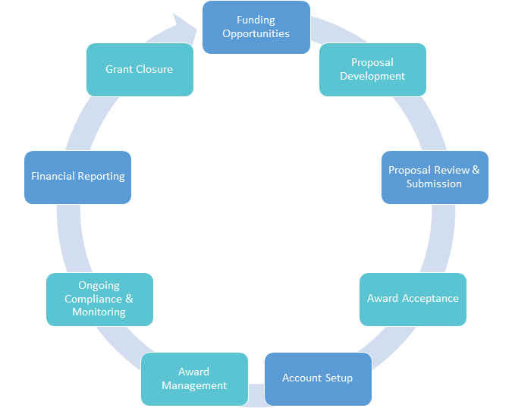

Research Grants Cycle
Post-award Administration

Slide 6
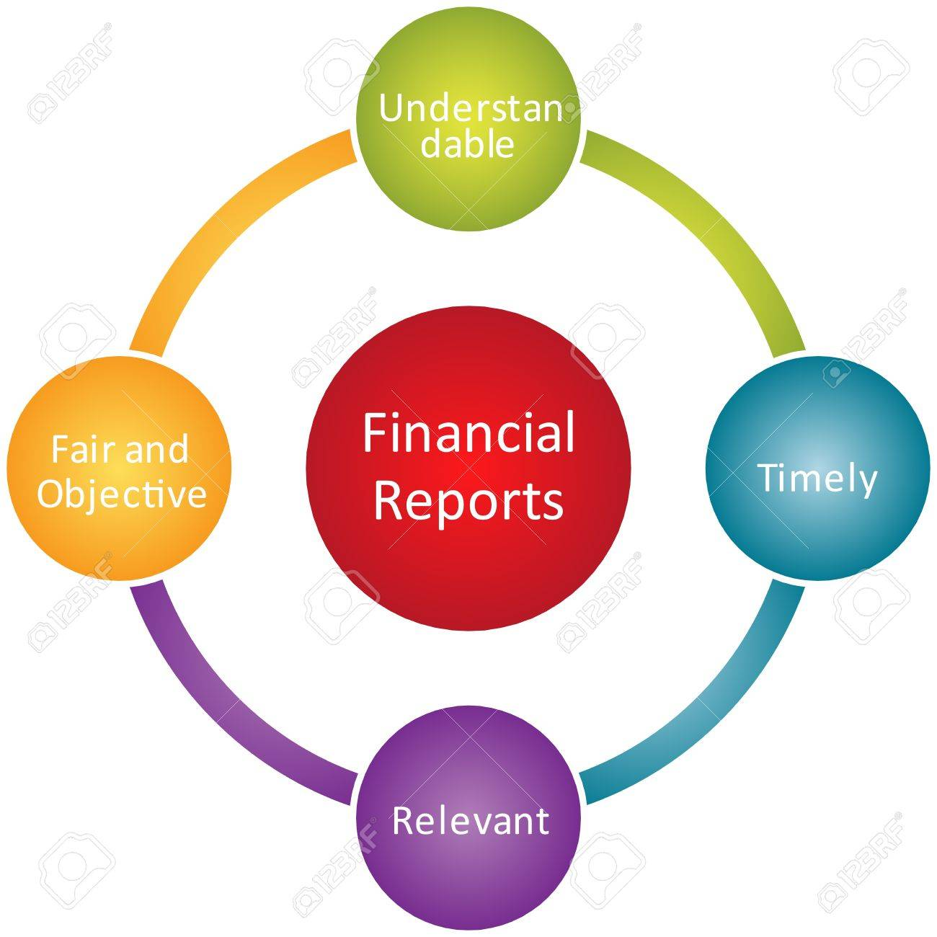
We will cover…
What is FRS?
How to gain access?
What is FUGPO?
Live overview.
Important links.

Slide 7
The What, Who, and How of FRS?
FRS is a financial reporting system, not our financial system
Finance system is Oracle
  It is rather old and will be replaced
Access is by request and approval
  FRS application form submitted to the Controller’s Office for review / approval and access
  Based on a need to have access basis

Slide 8
U of G account code (FUGPO)
Fund 3 digits | Unit 6 digits | Grant 6 digits | Project 6 digits | Object 5 digits
Purpose for the funding: Operating (1XX) Capital (2XX) Endowment (4XX) Research (3XX) Ancillaries (5XX) | Responsible for the funding Eg. College, Dept., unit, etc… | For restricted / specific awards from donors or grantors Research Endowment | Specific project, within the Operating or Capital Fund Eg: capital projects, conferences | The transaction Asset Liability Revenue Expense Net assets

Slide 9
Important Links
Training site: https://www.uoguelph.ca/frstraining/
FRS direct link to sign on: https://frs.fin.uoguelph.ca/pls/fmrt/f?p=1000:1:1996383345108:::::
Contact Research Financial Services: https://www.uoguelph.ca/finance/research-financial-services-contacts
Access to FRS: https://www.uoguelph.ca/finance/departments-services/controllers-office/management-financial-systems-frs-adi-etc/financial-reporting

Slide 10

Questions?
Thank you.

