Slide 1


RESEARCH GRANTS
- UPDATES -
Éric Bastien, DIRECTOR, RESEARCH GRANTS AND PARTNERSHIPS
May 2019

Slide 2
outline
SSHRC Context and Priorities
Highlights of Budget 2019
Budget 2018 and Priority Setting
  New Frontiers in Research Fund (NFRF)
  Employment Equity and Diversity (EDI)
  Early Career Researchers
  Indigenous Research Capacity and Reconciliation
Grant Programs and Updates
  Insight
  Connection
  Partnerships
Collaborative Initiatives
SSHRC Impact Awards
SSHRC Policy Updates

Slide 3
SSHRC context and priorities

Slide 4

Our role
Federal agency mandated to promote and support postsecondary-based research and training in the social sciences and humanities
Through grants, fellowships and scholarships SSHRC:
  Trains the next generation of talented, creative thinkers and doers
  Builds knowledge and understanding about people, cultures and societies
  Drives the innovations that address the challenges of today and tomorrow

Slide 5

FEDERAL GRANTING AGENCIES
Minister of Health
Minister of Innovation, Science
and Economic Development
Minister of Science
Chief Science Advisor
Canadian Institutes
of Health Research
(CIHR)
Social Sciences and
Humanities Research
Council (SSHRC)
Natural Sciences and
Engineering Research
Council (NSERC)
Genome
Canada
Canadian
Foundation
for Healthcare
Improvement
Common Administrative Services Directorate (CASD)
Vanier Canada Graduate Scholarships
Banting Postdoctoral Fellowships
Canada Research Chairs
Canada Excellence Research Chairs
Research Support Fund
Canada First Research Excellence Fund
New Frontiers in Research Fund
Network of Centres of Excellence
College and Community Innovation
Canada
Foundation
for Innovation
(CFI)

Slide 6
Highlights - BUDGET 2019
Measures to help more students to access graduate studies and further improve equity, diversity and inclusion in the research system.
$114 million* over five years, with $26 million per year ongoing, to the Tri-agencies to create 500 more master’s level scholarships and awards annually and 167 more three-year doctoral scholarships and fellowships annually through the Canada Graduate Scholarships Program.
  *$48 million is for SSHRC
$37.4 million* over five years, starting in 2019-20, and $8.6 million per year ongoing, to the agencies, to expand parental leave coverage from six months to 12 months for students and postdoctoral researchers who are funded directly or indirectly by agency funds.
  * $9 million is for SSHRC

Slide 7
Budget 2018 and priority setting
Fundamental Science Review – high priority on investigator-led research
Key priorities of Canada Research Coordinating Committee (CRCC)
  International, multidisciplinary, high-risk and rapid-response research
  Emerging areas of research
  Equity, diversity and inclusion in research
  Reconciliation with First Nations, Métis and Inuit
  Development of early career researchers
Budget 2018 included the largest single investment in research in Canada’s history; instrumental in carrying out the CRCC’s priorities.

Slide 8

New frontiers In research fund (NFRF)
Fund will support research that is international, interdisciplinary, fast-breaking and higher-risk;
NFRF represents a fundamental shift in how Canada invests in research and supports collaboration among non-traditional partners
Flag-ship tri-agency initiative, innovative approach
Administered by SSHRC on behalf of the councils

Slide 9
Three streams to support groundbreaking research:
Exploration will generate opportunities for Canada to build strength in high-risk, high-reward and interdisciplinary research
Transformation will provide large-scale support for Canada to build strength and leadership in interdisciplinary and transformative research
International will enhance opportunities for Canadian researchers to participate in research with international partners

Slide 10

Tri-Agency Equity, diversity and inclusion (EDI) Plan
The CRCC has drafted an action plan with three strategic pillars:
Fair access to research support – current understandings of “research excellence” to be reviewed and reframed
Equitable participation – increase participation from underrepresented groups in the research enterprise
Data for evidence-based decision-making – self-identification modules for applications

Slide 11

Early career researchers (ECRs)
The CRCC has drafted an action plan with three strategic pillars:
Fair access to Tri-Agency research support – Provide access to research funding opportunities designed to support the establishment of ECR’s academic research careers
Equitable participation in the research system – Support ECRs in developing the required skills, experience and opportunities to establish their research careers
Data for evidence-informed decision-making – Establish reporting standards to accurately track, monitor and inform decisions regarding the success of ECRs in academia

Slide 12
TRC65 and CRCC priority: Strengthening Indigenous Research Capacity
Budget 2018 implementation
April 2018
Spring 2019
Budget 2018: Develop a strategic plan that identifies new ways of doing research with Indigenous communities, including strategies to grow the capacity of Indigenous communities to conduct research and partner with the broader research community.
CRCC commitment (Priority 4): Develop, in partnership with Indigenous communities, an interdisciplinary, Indigenous research and research training model that contributes to reconciliation with First Nations, Métis and Inuit Peoples.
Agency-led Engagement
(O & M) $540,000
Leverage Ongoing Engagement with:
Indigenous Research Organizations
(e.g., AFN, ITK, MNC, NWAC, Pauktuutit, NCTR)
Postsecondary Institutions
Indigenous Advisory Circle
National Dialogue
(with CRCC)
March 2019
Draft Strategic Plan
Presented to CRCC
Spring 2019
Regional Events roundtables, workshops
Online Engagement
Sept-Dec 2018
Participants: Indigenous organizations
Indigenous and non-Indigenous researchers & students
CRCC, CFI and Tri-agency representatives
Key stakeholders and rights-holders: government, business, community
Indigenous & Scholarly-led Engagement
(G & S) $2.5 million
Special Targeted Call: Connection Grants
50 @ $50K
Indigenous Organizations and
Research Community
June 2018 launch – September 2018 deadline
CG* Awards
October 2018
Interdisciplinary Events and Outreach Activities
October 2018 - February 2019
*CG: Connection Grants

Slide 13

Development of a strategic research plan that identifies new ways of doing research with First Nations, Métis and Inuit communities
Engagement process with two streams:
  Granting agency engagement with Indigenous organizations and researchers leading to a national dialogue in March 2019
  Special Call: Indigenous Research Capacity and Reconciliation (Connection Grants) – leading to the development of position papers that will contribute to the National Dialogue

Slide 14
Insight
Connection
Partnerships
Grant programs update

Slide 15

$388.2 million for grants, fellowships and scholarships
$0.94 out of every allocated
dollar goes directly to fund
researchers and students
Fast Facts
2017-18
Over 12,500 funding applications received
More than 4,200 new grants, fellowships and scholarships awarded
4,400 volunteer external assessors and experts support
the review of funding applications.

Slide 16
FUNDING OPPORTUNITIES
TALENT
Building the next generation of leaders and equipping them for research-intensive careers across the economy and society
INSIGHT
Fostering research-based
knowledge about people
CONNECTION
Supporting the flow and exchange of that knowledge within and beyond academe.
• Master’s Scholarships
• Doctoral Scholarships
• Postdoctoral Fellowships
• Insight Development Grants
• Insight Grants
• Support to institutions
• Connection Grants
• Support for Journals
• Knowledge Synthesis Grants
Partnerships
Partnership Engage Grants
Partnership Development Grants
Partnership Grants
Within the academic community and between academe, industry, government, not-for-profits and communities

Slide 17
Taking stock: Increase in percentage of faculty supported
As Budget 2018 Investments ramp up, by 2023 the percentage of the SSH community supported by SSHRC’s Insight Program (IG and IDG) will reach :
30%
In addition, Partnerships programs will support between 10% and 13% and SSHRC Institutional Grants (SIG) will continue to support an estimated 4% of the community.
15.4%
24.2%
Program changes to IG and Budget 2016 ($16M for Insight) led to an increase by 2017
28.4%
Steady level of support at 14% to 18% from 1999 to 2014
After Year 2 of Budget 2018 Implementation
2019
2017
2014
Percentage of the Community Supported by SSHRC Insight grants:
Population data from UCASS
“Supported” includes Applicants and Co-applicants
Calculated using “unique” researchers supported
SRG/RDI data used from 1999 to 2011, then IDG/IG

Slide 18
Small and Medium Institutions: SSH Faculty Supported

Slide 19
Insight development grants
Program Parameters:
Duration: 1 – 2 Years
Value: $7,000 - $75,000

Slide 20
INSIGHT GRANTS
Program Parameters:
Duration: 2 - 5 Years
Value: $7,000 - $400,000

Slide 21
INSIGHT GRANTS: 2 STREAMS
2018-19 Stream A | Stream B
Duration: 2-5 years Value: $7K to $100K *Success rate significantly higher than Stream B | Duration: 2-5 years Value: $100K to $400K
736 Applications / 376 Awards Success Rate: 51.6% Total Invested: $29,303,649 Researchers Supported: 839 | 815 applications / 351 Awards Success Rate: 43.5% Total Invested: $72,359,391 Researchers Supported: 1363
As predicted, we noted that more applications were submitted to Stream A by researchers in the Humanities, but also in some social sciences disciplines such as Economics, Management, Business and related fields.
Both streams were adjudicated by the same committee and received the same rigorous level of merit review, including input of external assessors
Committee received separate budget envelopes dedicated to each stream

Slide 22
CONNECTION grants
Program Parameters | Notes
Value: $7,000-$25,000 (Events) or $50,000+ (Outreach) Duration: 1 year Deadlines: May 1, August 1, November 1, February 1 (8 p.m. EST) | Streams: Individual and Institutional Results Announcement: End of funding cycle Sponsor Investment: ≥ $0.50 for every $1 of SSHRC investment Success Rate 2012-2018: 60.4%

Slide 23
PARTNERSHIPS
SSHRC funds partnerships through Partnership
and Partnership Development Grants to:
conduct research;
mobilize knowledge; and,
train future researchers.
For 2017-18, 900 new Partners are expected to
contribute $62.0 M over 7 years.
POST-SECONDARY $34.6 M
Between 2013 and 2017 (5 years) SSHRC support facilitated…
• 450 formal partnership projects
• 3,300 partner organizations
• $245 M in partner contributions (cash and in-kind)
GOVERNMENT $5.6 M
INDUSTRY $9.7 M
NOT-FOR-PROFIT $12.2 M

Slide 24

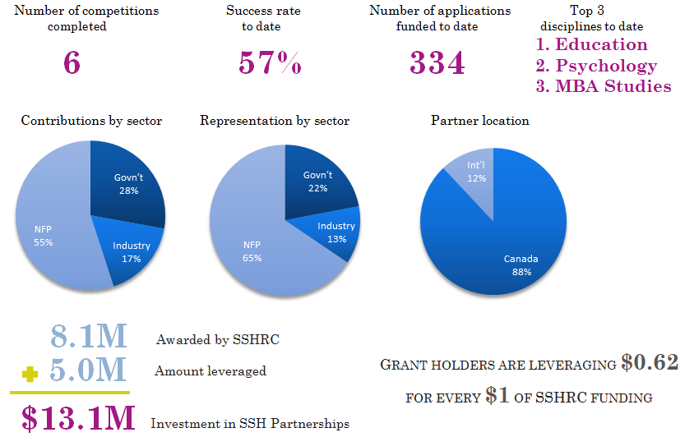
*Next deadline
June 17th, 2019

Slide 25
PARTNERSHIP Development grants
Program Parameters:
Duration: 1- 3 Years
Value: $75,000 - $200,000

Slide 26
PARTNERSHIP grants
Funding Opportunity | Year | Program Parameters | Results
PG | 2017-2018 | Value: Up to $20,000 (stage 1) Max. $500,000/year up to 2.5 million in total (stage 2) Duration: 4 to 7 years | Applications received: 73 Awards: 18 Success Rate: 24.7% Total Investment: $44,865,443

Slide 27
SPECTRUM OF SCALE, DURATION AND IMPACT
PARTNERSHIP ENGAGE GRANTS ($7-25K)
PARTNERSHIP DEVELOPMENT ($75-200K)
PARTNERSHIP GRANTS ($500K-$2.5M)
Tri-Council
Programs
New
Frontiers in Research Fund
CONNECTION GRANTS ($7-50K)
SIG
Up to $7K
Exchange
Explore
INSIGHT DEVELOPMENT
($7-75K)
INSIGHT GRANTS (A) ($7-100K)
INSIGHT GRANTS (B) ($100-400K)
Small Scale
Short-term
≤ 1 Year
Med- Scale
Medium-term
Large Scale
Longer-term
2 – 3 Years
4+ Years

Slide 28
collaborative initiatives

Slide 29
Open Research area (ora) for the social sciences
Pre-call announcement
ORA will open in May 2019 with a closing date in August 2019
Proposals will be accepted for research in any area of the social sciences and will need to involve researchers from any three or more participating countries (Canada, France, Germany, United Kingdom) and be integrated across the participating countries.
The research should make an original and significant contribution to current scientific knowledge.
  For more information: partnerships@sshrc-crsh.gc.ca

Slide 30



Ongoing collaborative initiatives
Defense Research Initiative
(Insight, 2015-current)
Target areas are: Military organizational culture change, trust in autonomous intelligent systems, trust in diverse organizational teams and in cross-cultural settings
Offered with the Department of National Defense Research Initiative.
Sport Participation
Research Initiative
(Insight/Talent, 2005-current)
Target areas are: Participation, System performance, values and ethics, major games and events, economic and social development
Offered with Sport Canada to study quality sport participation.
Societal Implications of Genomics Research (Insight/Partnerships/Connection, 2016-current)
Offered with Genome Canada
support social sciences and humanities research and related activities pertaining to research in the field of genomics.

Slide 31

Opportunities for SSH researchers
Applicants working with Canadian businesses and/or eligible not-for-profit organizations may be eligible for internship co-funding, through the Mitacs Accelerate program
  SSHRC Postdoctoral Fellowship applicants working with Canadian business and/or eligible not-for-profit organizations are invited to apply for a Mitacs Elevate
  Streamlined review process that allows SSH researchers to participate in Mitacs Accelerate and increase the participation of SSH students and postdoctoral researchers in valuable internship opportunities

Slide 32

SSHRC Impact Awards
Deadline: April 1, 2019; results announced Fall 2019
Recognizing and celebrating the impact of SSHRC-funded researchers and students.
One award in each category
  Gold Medal: $100,000
  Talent Award: $50,000
  Insight Award: $50,000
  Connection Award: $50,000
  Partnership Award: $50,000
One nomination in each category per university

Slide 33
Policy Updates

Slide 34
Canadian Research and Development Classification (CRDC)
The development of the CRDC is led by the Tri-agencies, CFI, and Statistics Canada
The CRDC is a set of three interrelated classifications:
  Type of activity
  Field of research
  Socio-economic objective
Reflects contemporary and Canadian research landscapes and aligns Canada with international standards for collecting and reporting data on research
It will be a tool to facilitate peer review process and reporting on investment by federal research granting agencies and by the government of Canada
Plans for implementing CRDC 2019 in agency systems are still being developed.

Slide 35
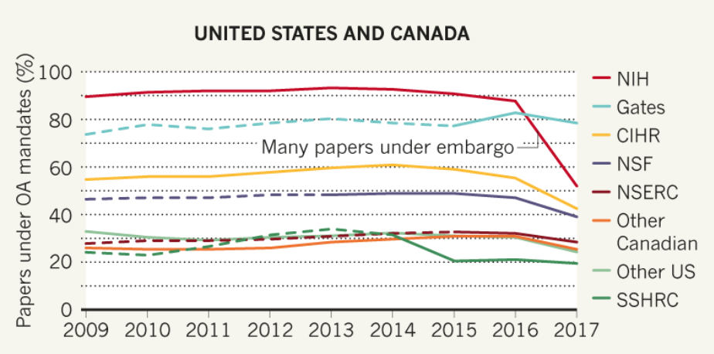
Very Varied Access*
NIH, US National Institutes of Health;
Gates, Bill & Melinda Gates Foundation;
NSF, US National Science Foundation;
CIHR, Canadian Institute of Health Research;
NSERC, Natural Sciences and Engineering Research Council;
SSHRC, Social Sciences and Humanities Research Council
– – – Before mandate adoption
* Larivière, V., Sugimoto, C. R. (2018). Do authors comply when funders enforce open access to research? Nature 562, 483-486
doi: 10.1038/d41586-018-07101-w
  Data sources: Unpaywall/Clarivate Analytics Web of Science/ROARMAP. Analysis: V.L. & C.R.S.

Slide 36
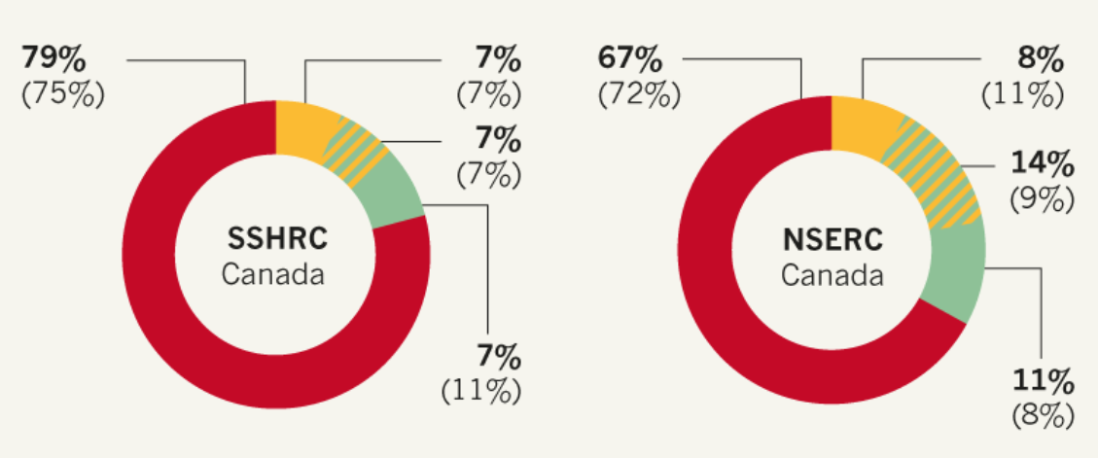
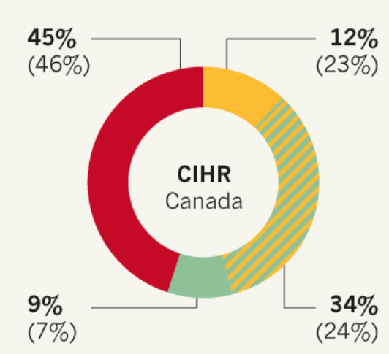
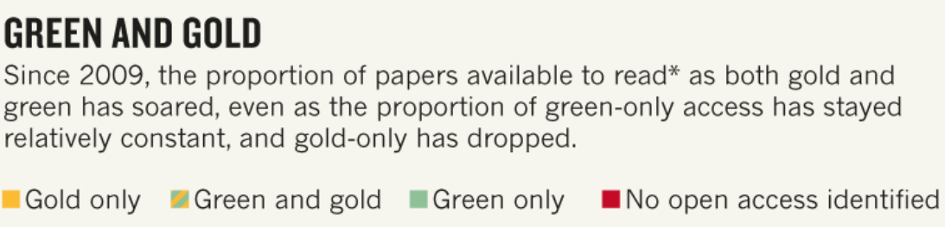
compliance with Tri-agency Open Access policy
Larivière, V., Sugimoto, C. R. (2018). Do authors comply when funders enforce open access to research? Nature 562, 483-486
doi: 10.1038/d41586-018-07101-w
Data sources: Unpaywall/Clarivate Analytics Web of Science/ROARMAP. Analysis: V.L. & C.R.S.

Slide 37

Draft Tri-Agency Research Data
Management Policy (2018)
Each institution is to create an institutional research data management strategy
For specific funding opportunities, the agencies may require data management plans
Grant recipients are to deposit into a digital repository all digital research data, metadata and code that directly support the research conclusions in journal publications stemming from agency-supported research

Slide 38
Connection Grants: Special call
Research Data Management Capacity Building Initiative
New Funding opportunity for 2019 - upcoming deadlines: May 1st and August 1st
Targeted call to help the SSH research community engage with existing and emerging standards for data management as a feature of excellent research, and to ready itself for the anticipated tri-agency policy.
Proposals must focus on increasing the capacity of a broad group of researchers or students to manage data as a regular research activity.
  Not eligible: proposals to conduct data management research, or for projects limited to management of particular datasets or databases.
Applications are subject to the Connection Grants evaluation criteria and scoring.
  In addition proposals must respond to one or more of five objectives outlined in funding opportunity description.

Slide 39
Do not hesitate to contact us
You can find lists of our Program Officers contact information on our website or send your request to one of our funding opportunity general inboxes.
Keep an eye out for upcoming webinars!
A few tips for your application preparation:
  Be creative and ambitious with KM plan.
  Provide justification: Do not presume adjudication committee members are familiar with the work, or with the specific terminology and particularities of the field of specialization.
  Give special attention to budget and provide good justification.
  Ensure students’ work/training is meaningful.

Slide 40


Stay connected with SSHRC
Visit our website: www.sshrc-crsh.gc.ca
Subscribe to our eNewsletter: Dialogue
Email me: Tim.Wilson@sshrc-crsh.gc.ca
@nietheid
@SSHRC_CRSH
Facebook
YouTube

